Slide 1


Brief Introduction on Global Sensitivity Analysis (GSA) and the SAFE Toolbox for GSA
Dr Valentina Noacco (NERC Knowledge Exchange Fellow)
Dr Francesca Pianosi (Lecturer in Water and Environmental Engineering)
Prof Thorsten Wagener (Professor of Water and Environmental Engineering)
Department of Civil Engineering University of Bristol
valentina.noacco@bristol.ac.uk
Grant Ref: NE/R003734/1

Slide 2

What is Sensitivity Analysis? and why shall we use it?
Sensitivity analysis (SA) is:
set of mathematical techniques which investigate how uncertainty in the output of a numerical model can be attributed to variations of its input factors.
Benefits:
Better understanding of the model Evaluation of model behaviour beyond default set-up
Model “sanity check”
Does the model meet the expectations (model validation)
Prioritize investments for uncertainty reduction Identify sensitive parameters for computer-intensive
calibration, acquisition of new data, etc.
More transparent and robust decisions Understand main impacts of uncertainty on
modeling outcome and thus on decisions

Slide 3

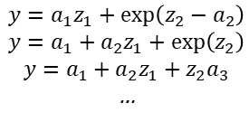
How Global Sensitivity Analysis works
INPUT FACTORS included in SA
SIMULATION RESULTS
Forcing inputs
x1
time
latitude
…
Parameters
time
MODEL
longitude
x2
x3
x4
(spatially or temporally distributed)
x5
Spatial resolution
OUTPUTS
$$y=a_{1}z_{1}+\exp\left(z_{2}−a_{2}\right)$$
$$y=a_{1}+a_{2}z_{1}+\exp\left(z_{2}\right)$$
$$y=a_{1}+a_{2}z_{1}+z_{2}a_{3}$$
…
Structure (equations)
(…)
x6
pdf
output 1
output 2
INPUT SAMPLING
MODEL EVALUATION
GSA
output 1
output 2
Sensitivity Index
model inputs:
x1 x2 x3 x4 x5 x6
x1 x2 x3 x4 x5 x6

Slide 4
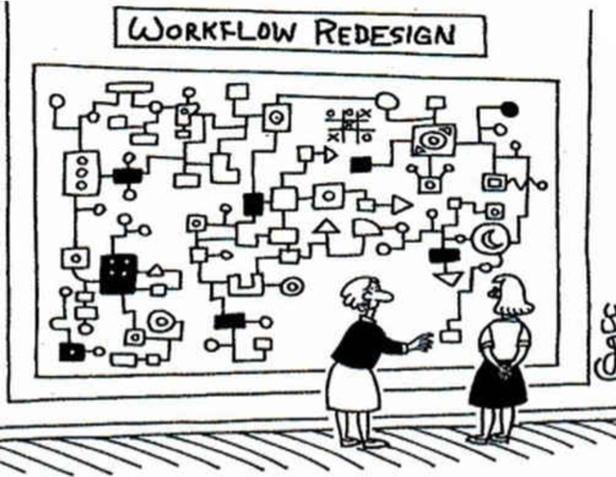
We aim to transfer GSA to practitioners and integrate it in their modelling workflows
We want to use workflows as a way to transfer expertise.
Often workflows exist only in the users head.
Workflows we produced include guidance on:
how to produce GSA results, and
how to interpret these results.
To this end we have developed an R markdown script to guide in the application and interpretation of SA for models which run in R or Excel.
“And this is where our workflow redesign team went insane.”

Slide 5
GSA Workflow
User’s choices
EXPERIMENT SETUP
Choose the input factors subject to SA
Define other model inputs not subject to SA
Define the scalar model output(s)
SA steps
Choose the SA method(s)
1. INPUT SAMPLING
Define the input variability space (ranges/PDFs/ …)
Choose the sampling strategy (random uniform, latin hypercube,…)
Choose the sample size (depending on the SA method and number of input factors)
2. MODEL EVALUATION
Recommended practice
Check model behaviour (and possibly filter out samples)
3. POST PROCESSING
(GSA)
Assess robustness and convergence
Visualize results
Assess credibility of SA

Slide 6
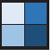
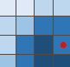
What would be the input factors and outputs in a flood inundation model?
Input factors
Model output
MODEL EXECUTION
y
x₁ x₂ x₃ x₄ x₅
output 1
(time-varying output)
(Flood extent)
Spatial Resolution
x₁
time
or
Digital Elevation Model
x₅
output 2
latitude
(spatially-varying output)
Floodplain Friction
x₃
(Maximum water depth)
longitude
Channel Friction
x₂
Discharge (m³s⁻¹)
Time (hours)
Inflow Hydrograph
x₄
Savage et al. [2016] (Water Resources Research)

Slide 7

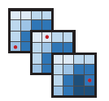
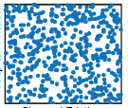
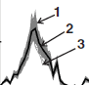
SA would perturb the input factors… which changes the outputs
Input factors
Model output
MODEL EXECUTION
y
…
x₁ x₂ x₃ x₄ x₅
output 1
3
…
(time-varying output)
2
3
(Flood extent)
1
2
time
1
or
latitude
output 2
Spatial Resolution
x₁
(spatially-varying output)
Digital Elevation Model
x₅
(Maximum water depth)
longitude
Floodplain Friction
x₃
Discharge (m³s⁻¹)
Channel Friction
x₂
Time (hours)
Inflow Hydrograph
x₄
Savage et al. [2016] (Water Resources Research)

Slide 8
…and then estimate Sensitivity Indices
Input factors
Model output
MODEL EXECUTION
y
…
x₁ x₂ x₃ x₄ x₅
output 1
3
…
(time-varying output)
2
3
(Flood extent)
1
2
time
1
or
latitude
output 2
Spatial Resolution
x₁
(spatially-varying output)
Digital Elevation Model
x₅
(Maximum water depth)
longitude
GSA
longitude
Floodplain Friction
x₃
output 1
output 2
Discharge (m³s⁻¹)
Channel Friction
x₂
Sensitivity Index
Time (hours)
Inflow Hydrograph
x₄
model inputs:
x1 x2 x3 x4 x5
x1 x2 x3 x4 x5

Slide 9
Difference between calibration and SA
The ‘calibration’ question: What is the right (or a reasonable) choice for the input factors (i.e. produce a sensible model output)?
The ‘sensitivity’ question: How much varying each input factor contributes to variability of the model output?

Slide 10
Local vs Global approaches to SA
Local methods analyze sensitivity around some point in the factor space.
Global methods attempt to analyze variability across the full factor space.
Global methods require a good definition of the space you are going to sample
y = f(x₁,x₂,x₃)
input factor x₃
input factor x₃
input factor x₁
input factor x₁
input factor x₂
input factor x₂
1
0.5
0
x₁
x₃
input factors
Sensitivity Index
x₂
-40 -20 0 +20 +40
output variation
x₁ x₂ x₃
input factors
Local methods require a good ‘baseline’ or ‘nominal point’.

Slide 11
SA allows to achieve different objectives
Ranking
Which input factors have more influence on the model’s response?
Screening
Is there any input factor that has negligible influence on the model’s response?
Model inputs
Model inputs
Then possible SA methods:
Regional Sensitivity Analysis
Elementary Effects
Variance Based
Then possible SA methods:
Elementary Effects
Variance Based
Sensitivity Index
Sensitivity Index
x1 x2 x3 x4 x5
x1 x2 x3 x4 x5
→ x₃ > x₅ > x₄ > x₁ > x₂
→ x₄ non influential
Mapping
Are there subranges of the input factors that map into “significant” (e.g. extreme) output values?
Input factors
Model output
Then possible SA methods:
Regional Sensitivity Analysis
Classification and Regression Trees
x₁ x₂ x₃ x₄ x₅
Output (e.g. flood depth) above a threshold
→ specific subranges of the inputs give a flood depth above a threshold

Slide 12
Classification of SA methods
SA purpose
Sampling approach
Screening
Ranking
Mapping
Type of SA
~M
Perturbation & derivatives
LOCAL
One At the Time
(OAT)
Multiple-starts perturbation
EET
~10-100 x M
DELSA
Monte-Carlo filtering
RSA
>100 x M
Correlation & Regression Analysis
CC,PCC, SRCC, PRCC,CCA
Number of model evaluations
CART
GLOBAL
LR (SRC)
All At the Time (AAT)
Variance- based
&
Density- based
eFAST , FAST
>1000 x M
entropy-based
δ-sensitivity
VBSA
M: number of input factors

Slide 13

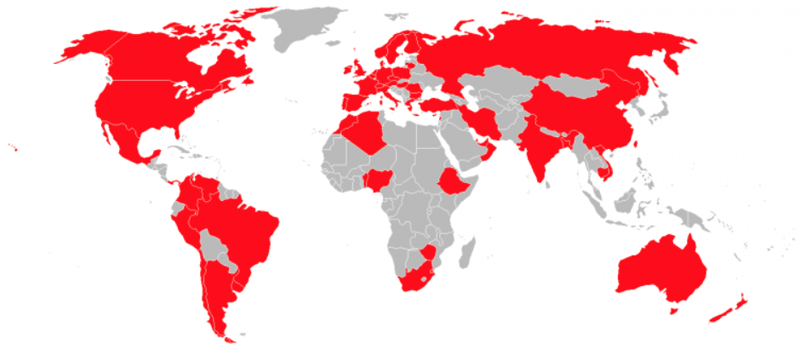

SAFE (Sensitivity Analysis For Everybody) Toolbox
Developed in 2014 by Pianosi et al.
Over 1300 users in academia and industry
in 50+ countries
Developed in R and Matlab (Python version under way)

Slide 14

The modular structure of SAFE
GSA steps
folders in SAFE Toolbox
 | X
1
2
…
N
 | 1 | 2 | … | M
sampling
AAT_Sampling.m OAT_sampling.m lhcube.m
lhcube_shrink.m
lhcube_extend.m
input samples
SAMPLING INPUT SPACE
MODEL EVALUATION
 | Y
1
2
…
N
 | 1 | … | P
output samples
POST PROCESSING
Elementary Effects Test
EET
EET_indices.m EET_plot.m EET_convergence.m
Regional Sensitivity Analysis
RSA
VBSA
VBSA_indices.m VBSA_convergence.m VBSA_resampling.m
 | S
1
…
P
 | 1 | 2 | … | M
Variance-Based Sensitivity Analysis
sensitivity indices
…
Notes:
:: functionalities for assessing robustness of sensitivity estimates
:: tutorial scripts (workflows) to get started > learn by doing > make choices explicit > embed “good practices” > draft for user’ own application

Slide 15
References and additional material
Website to download SAFE:
https://www.safetoolbox.info/
Introductory paper to SAFE (open access paper):
https://www.sciencedirect.com/science/article/pii/S1364815215001188
A review of available methods and workflows for Sensitivity Analysis (open access paper):
https://www.sciencedirect.com/science/article/pii/S1364815216300287
Example application to handle the issue of epistemic uncertainty (due to climate change) in landslide hazard modelling:
https://www.nat-hazards-earth-syst-sci.net/17/225/2017/nhess-17-225-2017-discussion.html

Slide 16
Appendix

Slide 17

Insurance case study
Pricing model based on past losses experience.
It produces a price recommendation for the premium to be charged for a new risk to a given company to cover from all classes of business.
Objective of case study:
Identify where to focus efforts to reduce uncertainty when reviewing the model (i.e. ranking).

Slide 18
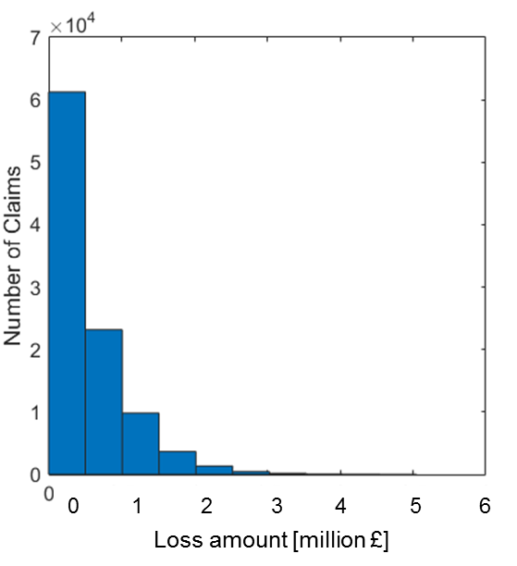
Simplified schematic of pricing model
x1. Frequency Trend
x2. Severity Trend
x3. Exposure Trend
x4. Development Pattern
mean
85th percentile
95th percentile
97.5th percentile
Claim data Exposure data Cover data
Portfolio and market data
Pricing model
Output: Loss amount
Choice of distribution of inputs
Notes:
A simplified version is this

Slide 19
Simplified schematic of pricing model with GSA
Sampling of inputs
x1. Frequency Trend
x2. Severity Trend
x3. Exposure Trend
x4. Development Pattern
Sensitivity analysis
1
0.5
0
Claim data Exposure data Cover data
Portfolio and market data
Sensitivity index
Pricing model
Output: Loss amount
x1 x2 x3 x4
model parameters
Choice of distribution of inputs
INPUT SAMPLING
MODEL EVALUATION
POST PROCESSING

Slide 20
Results
Summary:
Most influential inputs vary depending on the line of business, therefore this analysis helps to focus efforts to reduce uncertainty and enables to better communicate and outline to the underwriter the uncertainty in the model results due to the assumptions being used.
Varying the inputs within their credible range sensibly increases the variability of the model output, this should be taken into account while making decisions regarding the premium to charge to a client.
There are some unexpected behaviours in how the output responds to changing input values, this highlights areas where to focus when reviewing a policy (addressing these issues could improve the model).

Slide 21
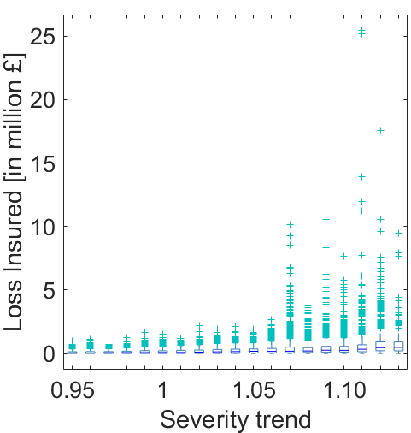
Varying the inputs within their credible range sensibly increases the variability of the model output
Benefit:
More transparent and robust decisions Understand main impacts of uncertainty on modeling outcome and thus on decisions
This analysis enables to better communicate and outline to the underwriter the uncertainty in the model results due to the assumptions being used.
Loss amount [million £]
0 0.2 0.4 0.6 0.8 1
Severity Trend

Slide 22
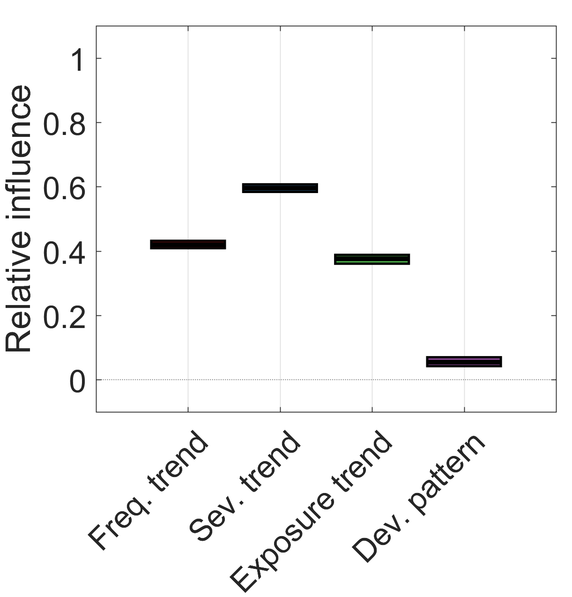
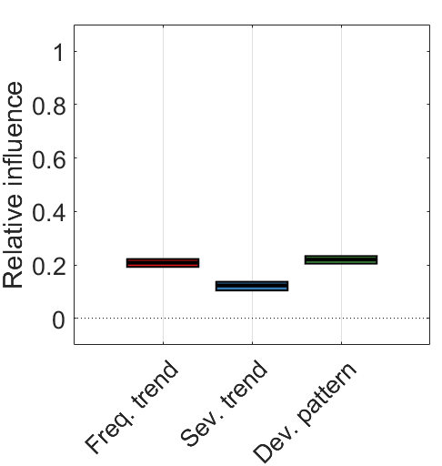
Most influential inputs vary depending on the line of business
Benefit:
Prioritize investments for uncertainty reduction Identify sensitive inputs for computer-intensive calibration, acquisition of new data, etc.
Line of business 1
Line of business 2
We should focus on different inputs to reduce uncertainty depending on the line of business. These inputs could be better estimated from portfolio data of businesses of similar nature.
Sensitivity index

Slide 23
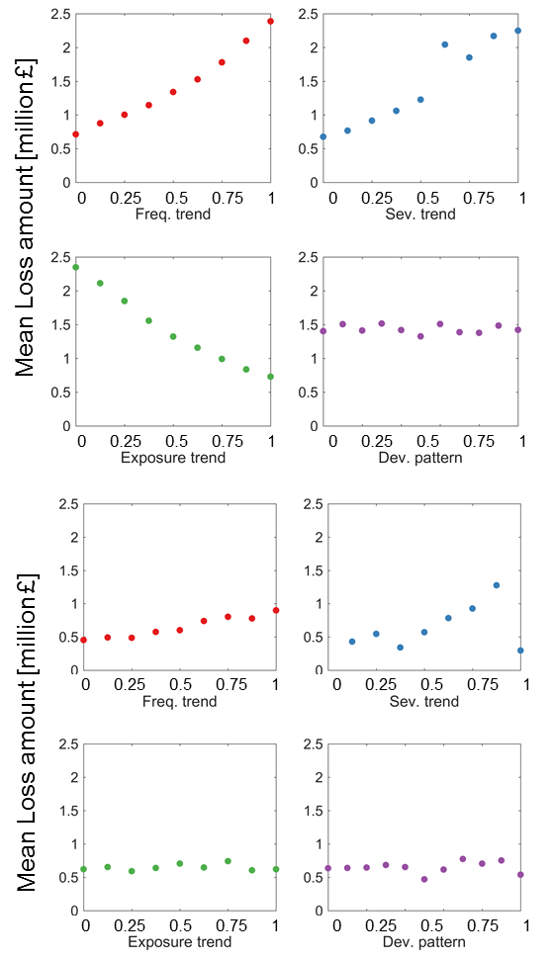


There are some unexpected behaviours in how the output responds to changing input values
Line of business 1
Benefit:
Sanity check” of the model
Does the model meet the expectations (model validation)
Frequency trend and Severity Trend were expected to increase output losses and vice versa for Exposure trend.
Severity trend has an incoherent behaviour for some values.
this highlights areas where to focus when reviewing a policy, where addressing these issues could improve the model.
Line of business 3

